Slide 1


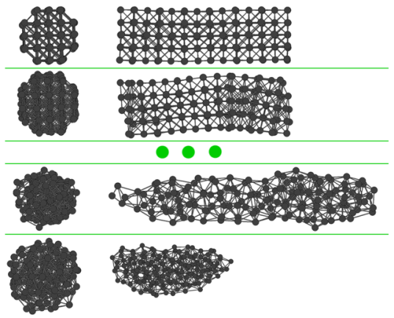
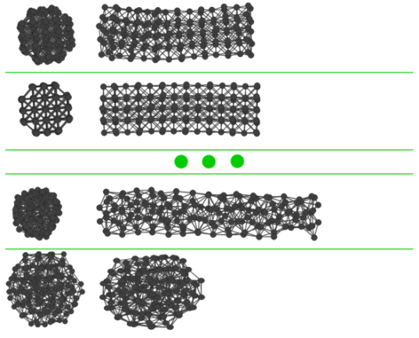
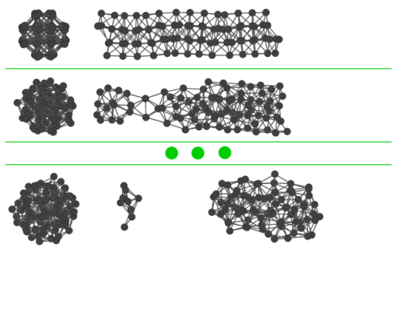
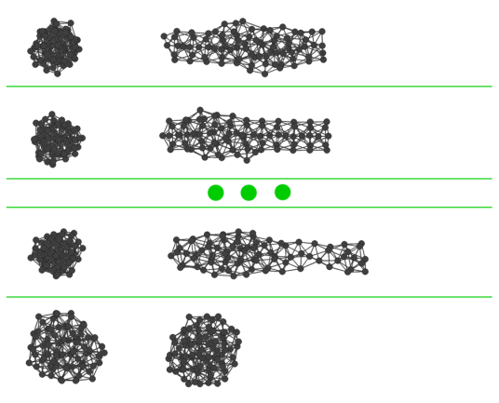
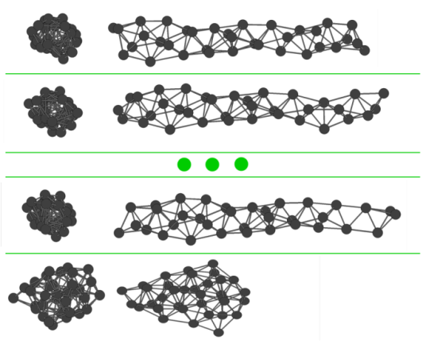
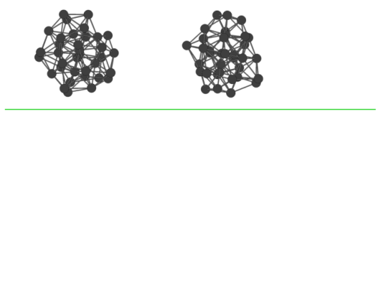
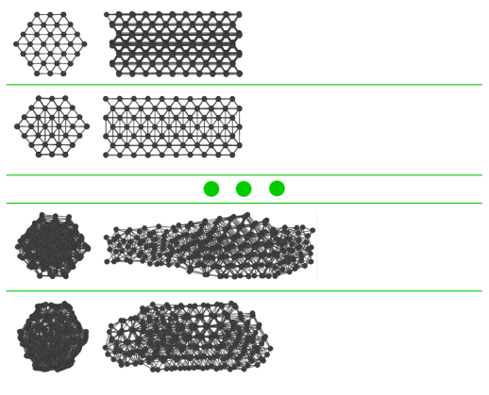
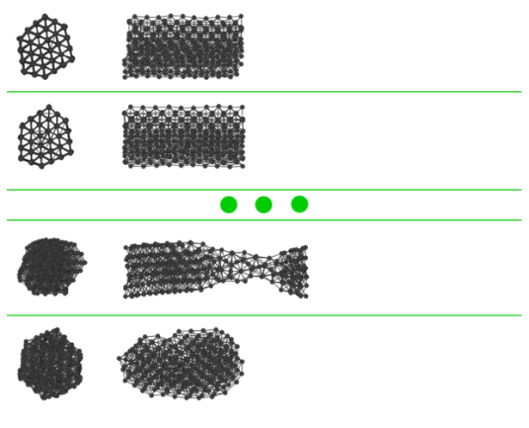
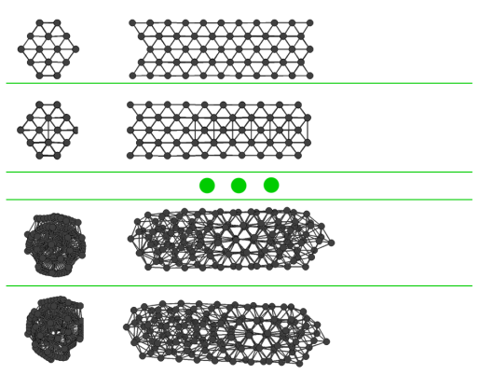
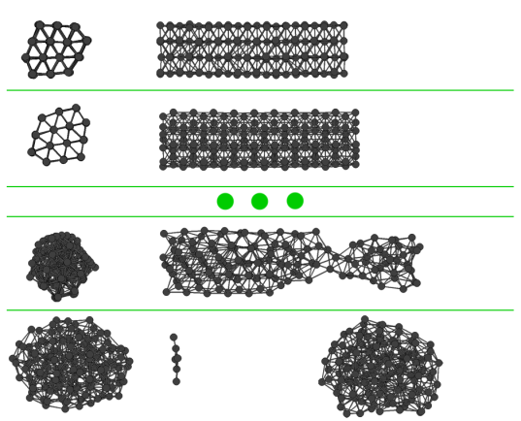
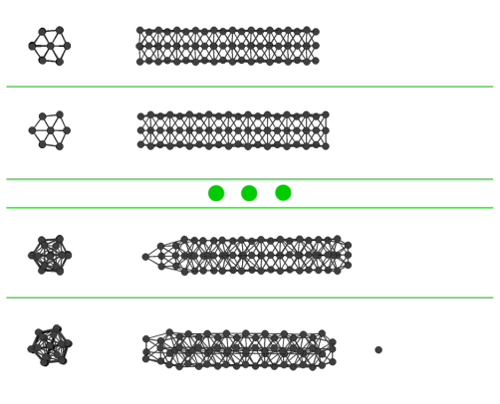
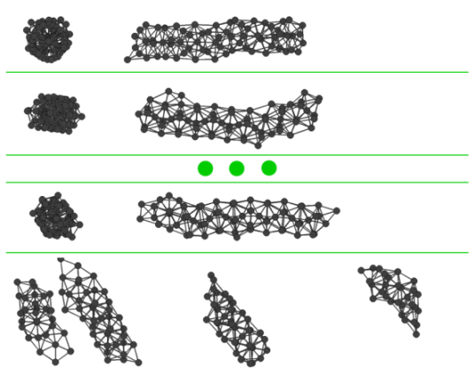
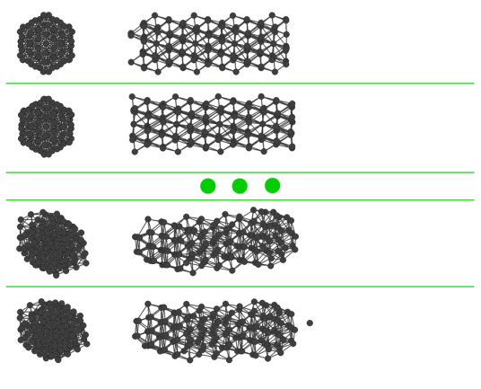
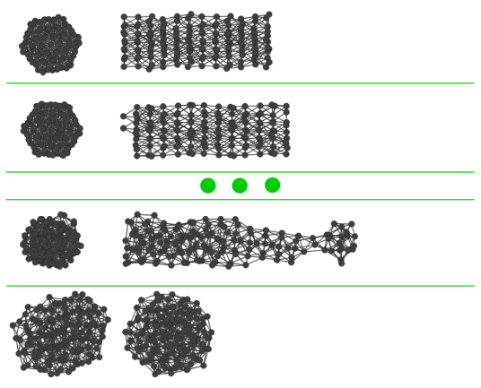
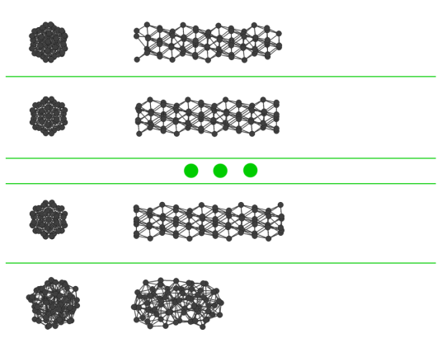
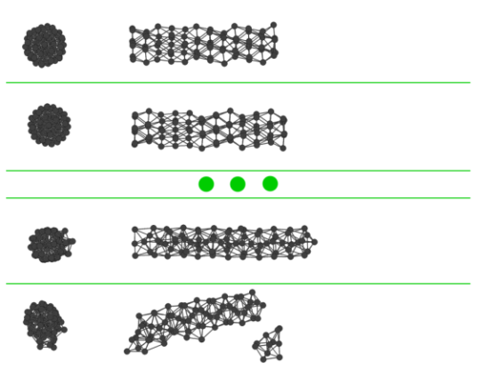
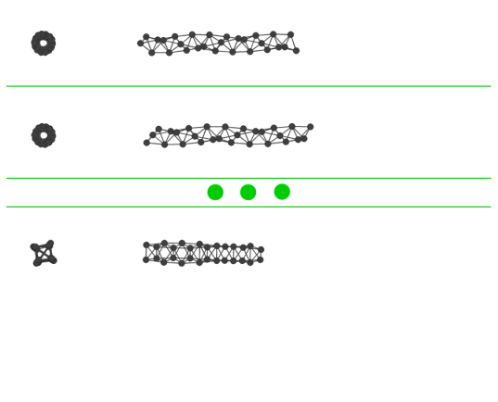
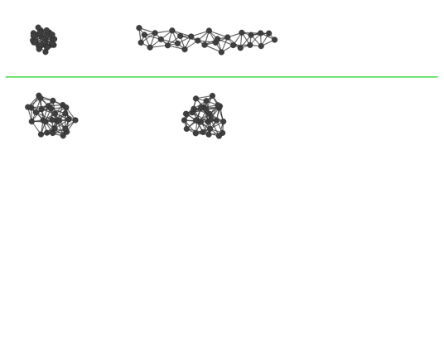
Structural Properties of Copper Nanorods under Strain: Molecular Dynamics Simulations
Hüseyin Yağlı¹, Şakir Erkoç^{1,2}
1. Micro and Nanotechnology Program, 2. Department of Physics, METU, 06531, Ankara
Abstract
Results
Structural properties of copper nanorods generated from low-index surfaces (100), (110), (111) under uniaxial strain have been investigated. Classical molecular dynamics simulations at various temperatures have been performed using an atomistic potential. It has been found that uniaxial strain shows cross section geometry dependent characteristics. The nanorods generated from (100) and (110) surfaces are relatively stronger against uniaxial strain than the nanorods generated from (111) surface.
1K
300K
Strain energy (eV) vs. Strain
Step 1
Step 1
Step 2
Step 2
Step 10
Step 13
100
Step 11
Step 14
Introduction
Step 1
Step 1
Step 2
Step 2
Copper nanorods and nanowires applications generally involve their magnetic and high conductive properties [1]. The excellent electrical conductivity and low cost of copper makes it ideal for applications in magnetic recording media, medical sensors and contrast enhancement agent for MRI [2]. A novel and interesting usage is the making of transparent-conductive films which can be used in flat panel displays, touchscreens and solar cells [3]. With their low cost compared to the currently used Indium Tin Oxide (ITO) and their flexibility, copper nanorods can greatly change the development of flexible displays, light emitting diodes and thin film solar cells.
Uniform arrays of copper 1D structures can be produced using simple liquid-solid reactions. Methods for obtaining different axial grown nanorods are present [4,5].
Step 3
Step 5
Step 6
Step 1
Step 1
Step 2
Step 3
Step 4
Step 1
Step 1
Step 2
Step 2
Step 10
Step 10
Methods of Calculation
Step 11
Step 11
In these atomistic level computer simulations the Erkoc empirical model potential was used [6]. The potential energy function (PEF) is formed from pair interactions, which contains many-body effects. The total energy of the system is expressed as the linear combination of two two-body functions [7]:
Ф = D₂₁ϕ₂₁ + D₂₂ϕ₂₂
where ϕ₂₁ and ϕ₂₂ are the two-body energies
, k=1,2
The two body interactions are defined as:
U_{ij}^{(2k)} = A_{k}r_{ij}^{-λk}e^{-αkr2ij} , k=1,2
Two sets of parameters are used (repulsive, attractive). The molecular dynamics time step is 0.9x10⁻¹⁵. The velocities and positions of the particles are calculated using the velocity summed form of Verlet algorithm.
The simulations for the nanorods are repeated at the temperatures 1K and 300K for all the rods. A minimum of 100.000 steps are repeated as a minimum for the systems to reach equilibrium.
Periodic boundaries are used in the related cross section direction. After each relaxation, the system is elongated by 5% and MD steps are repeated for the system to reach equilibrium again.
110
Step 1
Step 1
Step 2
Step 2
Step 7
Step 7
Step 8
Step 8
Step 1
Step 1
Step 2
Step 2
Step 6
Step 5
Step 7
Step 6
Step 1
Step 1
Step 2
Step 2
Step 6
Step 8
Step 7
Step 9
111
Step 1
Step 1
Step 2
Step 2
Step 3
Step 5
Conclusions
Step 4
Step 6
Step 1
Step 1
It has been shown that uni-axial strain shows cross-section geometry dependent characteristics. The nanorods generated from (100) and (110) surfaces are relatively stronger against uniaxial strain with respect to the nanorods generated from (111) surfaces. These results could help future researches for copper nanorods applications for their mechanical strength properties.
Step 2
Step 2
Step 3
References
[1] Yu Chang, Mei Ling Lye, and Hua Chun Zeng. Large-Scale Synthesis of High-Quality Ultralong Copper Nanowires. Langmuir 2005, 21, 3746-3748
[2] I.Lisiecki and A. Filankembo, H. Sack-Kongehl and K. Weiss, M.-P. Pileni, J. Urban. Structural investigations of copper nanorods by high-resolution TEM. (2000) PHYSICAL REVIEW B VOLUME 61, NUMBER 7.
[3] Rathmell, A. R.; Bergin, S. M.; Hua,Y.-L.; Li, Z.-Y.; Wiley, B. J. The Growth Mechanism of Copper Nanowires and Their Properties in Flexible, Transparent Conducting Films. Adv.Mater. 2010, DOI:10.1002/adma.201000775.
[4] X. G. Wen, Y. T. Xie, C. L. Choi, K. C. Wan, X. Y. Li, S. H. Yang; Copper-Based Nanowire Materials: Templated Syntheses, Characterizations, and Applications. Langmuir, 2005, 21 (10), pp 4729–4737 DOI: 10.1021/la050038v
[5] Reijnen, L.; Meester, B.; Goossens, A.; Schoonman, J. Chem. Vap. Deposition 2003, 9, 15.
[6] S. Erkoc, "An Empirical Many-Body Potential Energy Function Constructed from Pair-Interactions", Z. Phys. D: Atoms Molecules and Clusters 32, 257(1994).
[7] S. Erkoc, "Empirical Potential Energy Functions Used in the Simulations of Materials Properties", in "Annual Review of Computational Physics", Ed. D. Stauffer, Vol. IX, World Scientific, Singapore, 2001, pp. 1-103.

